Slide 1
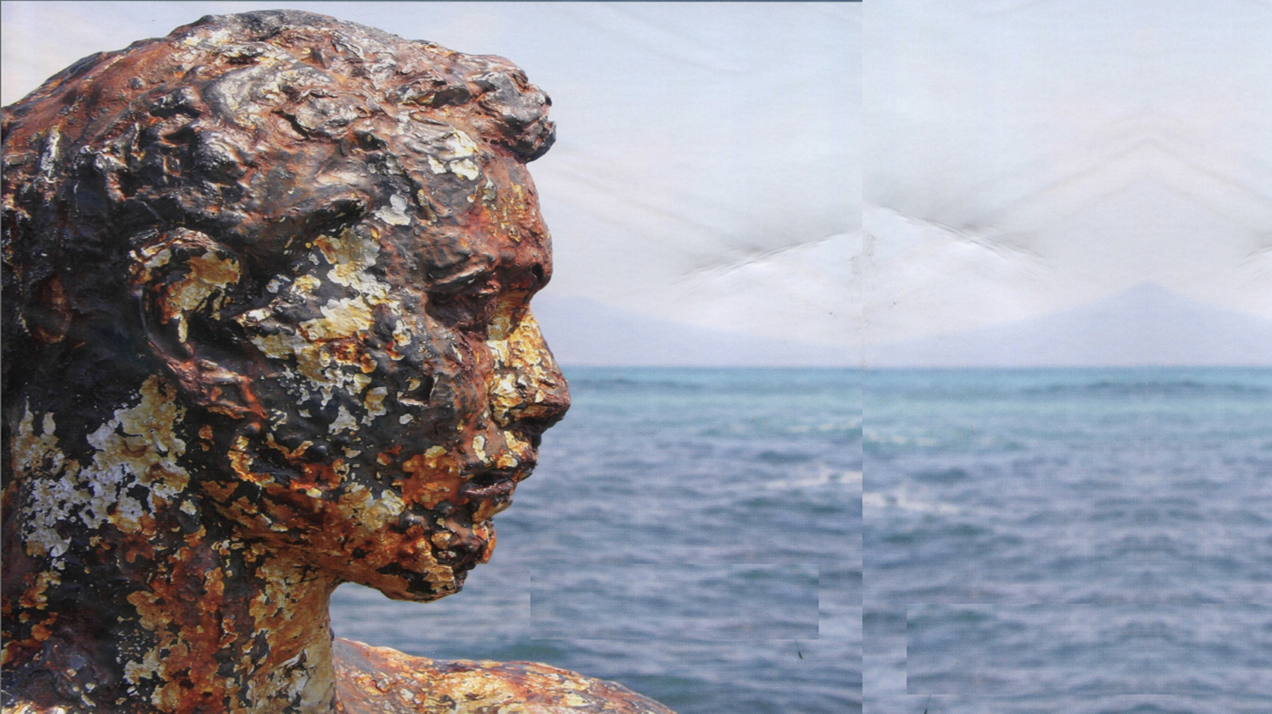



Laboratoire
Inflammation
Tissus
Epithéliaux et
Cytokines
UR15560
Dir: Franck MOREL
Assemblée générale du réseau Humain Recomposé et Reconstruit en Santé
26 mai 2025

Slide 2

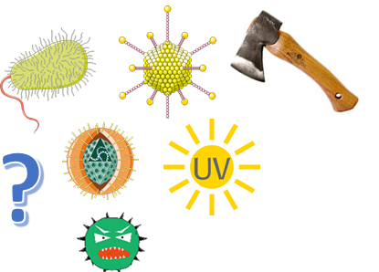
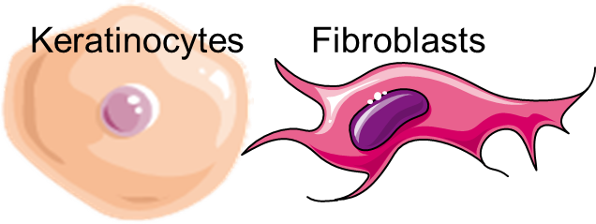
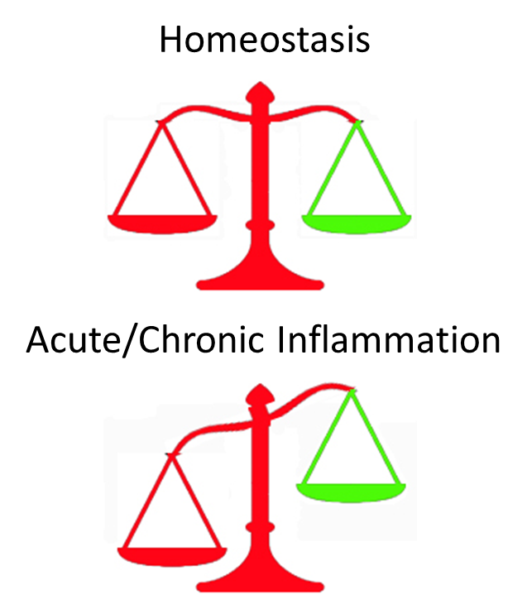
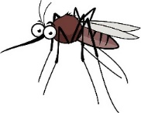


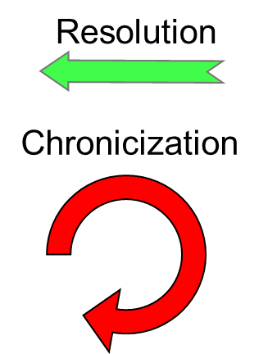
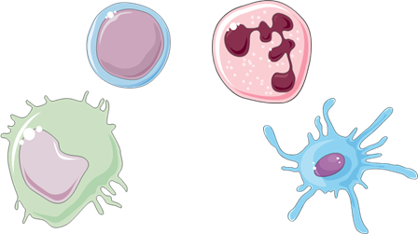
LITEC research domain
Agressors
Resident cells
Inflammation
Immune cells
Mechanistic
in vitro and in vivo models; links to pathophysiology
Translational research

Slide 3

Axis Inflammation : role of cytokines in immune cell / keratinocyte relationships
Epidermis Differentiation
Cytokines
Stress :
Danger signal or Pathogens…
MФ
PN
Inflammation
Th1/17
Th2
Cytokines
Keratinocytes
Immune cells
Acute inflammation
Chronic inflammation
Expression profiles
Regulations
Roles
Psoriasis
Atopic Dermatitis
Skin/Joint inflammation
Wound healing
Skin graft

Slide 4

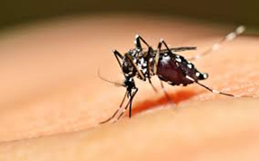
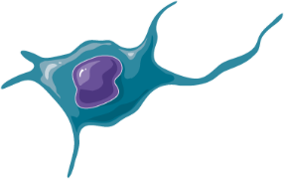

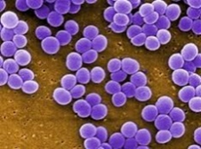
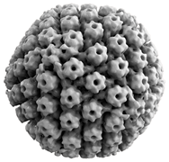
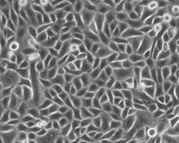
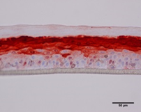
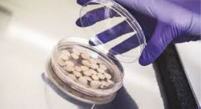
Axis Infection: study of pathogenic microorganism and skin cell relationships
Viruses, bacteria, toxins, PAMPs…
Cytokines
LC
DC
Inflammation
Th
Keratinocytes
Immune cells
Cytokines
Antimicrobial peptides
Models
Atopic dermatitis/dysbiosis
Inflammatory skin diseases/herpetic infection
Skin arboviral infections
Research theme aims to :
Pathophysiology of bacterial and viral skin infections
Investigate the impact of microbial virulence on the skin innate immune response
Focus on "microbial sensors", virulence factors and effectors of the antimicrobial response

Slide 5


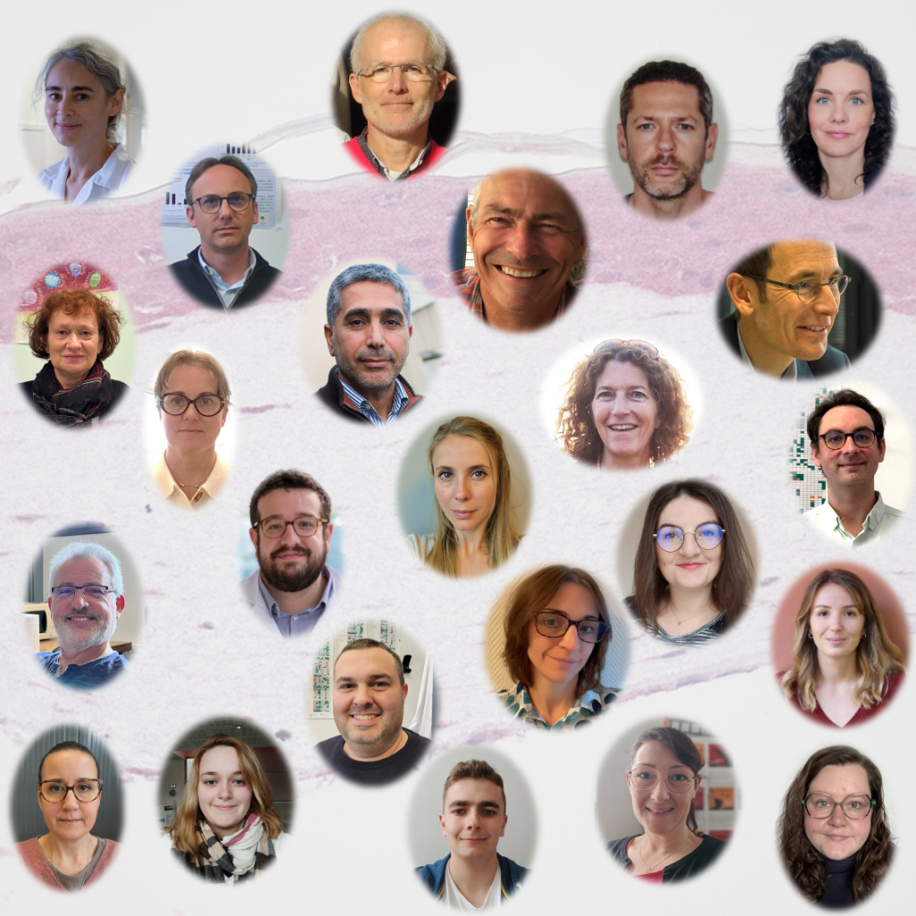





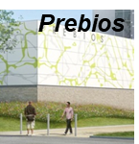
Charles BODET
Jean-François JEGOU
Laure FAVOT
Anne BARRA
Jiad MCHEIK
Florent CARSUZAA
Xavier DUFOUR
Luc DEROCHE
Elisabeth GERVAIS
Agnès RIOUX BILAN
Magali GARCIA
Nicolas LEVEQUE
Jean-Claude LECRON
Franck MOREL
  And former PhD students :
Katia BONIFACE
Emmanuel GUIGNOUARD
Karline GUILLOTEAU
Aina RABEONY
Mathilde POHIN
Philippe VASSEUR
Jean-Philippe GIOT
Marie SIMONNEAU
Alexia DAMOUR
Mélanie HUMEAU
Céline CHESSA
Eric FROUIN
Axelle VOUILLON
Florent CARSUZAA
  PhD students :
Magali CROQUETTE
Guillaume LARID
Matthieu BAINAUD
Hugo MAIN
Cynthia CAVILLON
Cassandre DUMONTEIX
IFR Biosanté

Slide 7

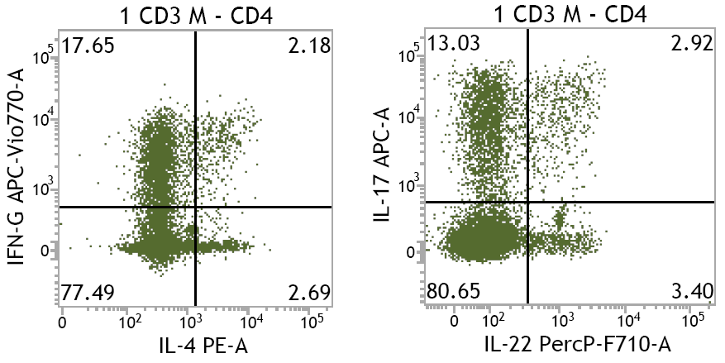
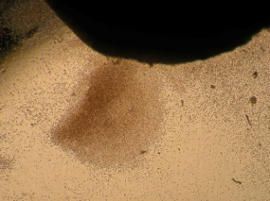
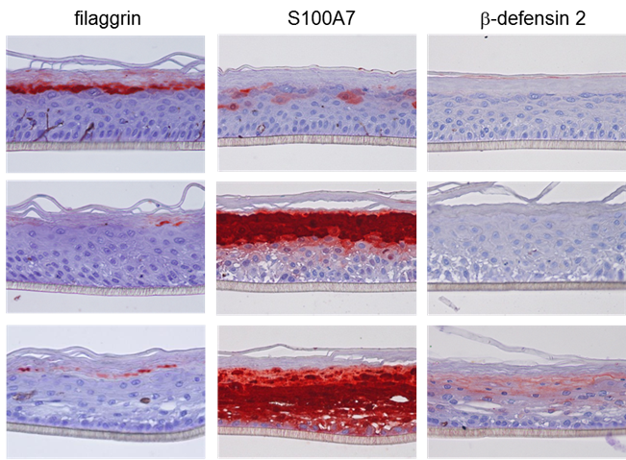
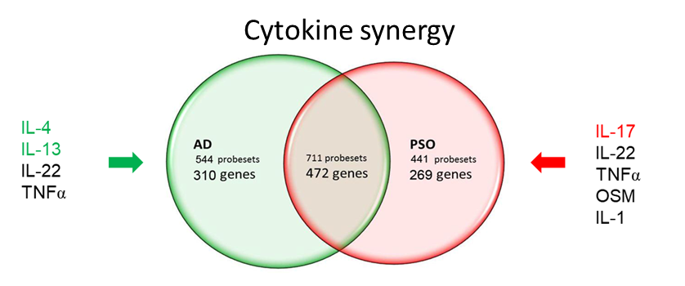
Cellular models
-T lymphocytes isolated from psoriatic skin lesions
IL-22
OSM
IL-17
TNFα
IFNγ
LTh17
LTh1
-In vitro reconstituted human epidermis
Crtl
AD
PSO
Atopic Dermatitis
Psoriasis
Progress in Inflammation Research 2013

Slide 8
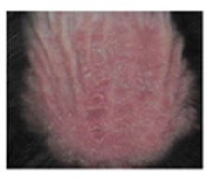
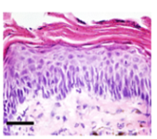
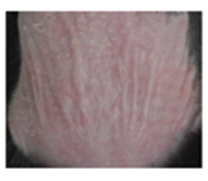
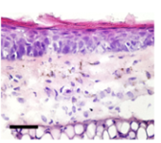
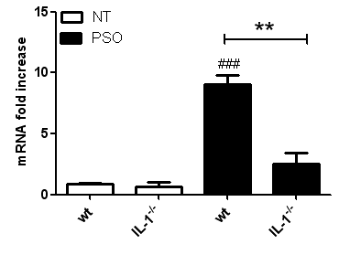
In vivo model of psoriasiform dermatitis
IMQ-induced Psoriasiform dermatitis
WT
IL-17A
IL-1^{-/-}
Control
IMQ
Rabeony et al, EJI 2015
Pohin et al, EJI 2016

Slide 9


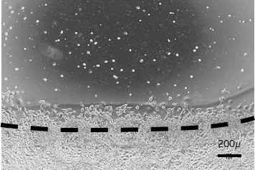
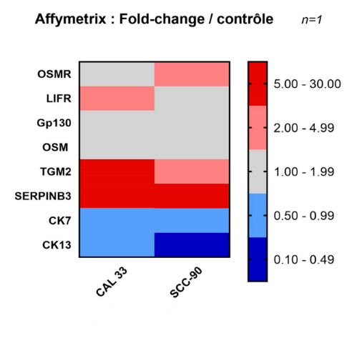
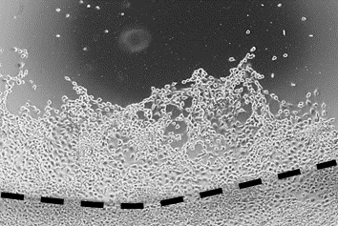
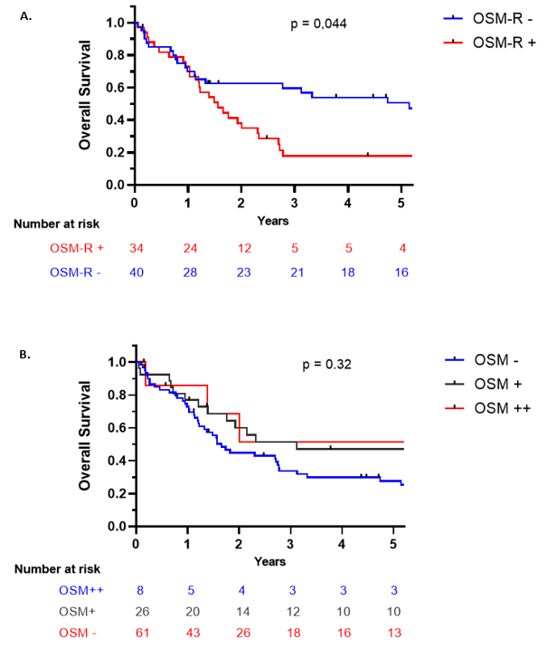
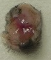
Oncostatin M and epidermoïd carcinoma
Cancer related inflammation
In vitro OSM induced
cancer cell migration
In vitro OSM induced loss of differentiation and EMT
IFNγ
IL-12
OSM 24H
Control
IL-4
IL-13
Pro-Tumoral Anti-Tumoral
OSM
In vivo OSM induces tumor growth
OSM a prognostic marker ex vivo
2500
WT
OSM Knock Out
***
2000
1500
***
47%
Tumor volume (mm³)
***
***
1000
**
500
0
0
10
20
30
Days

Slide 10

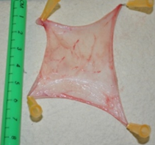
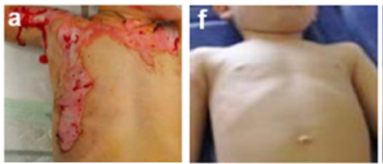
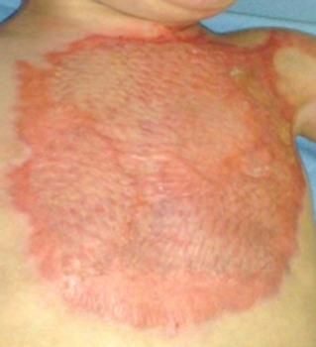

Translational research: Pediatric skin grafts using cell suspensions of isolated keratinocytes
In vitro
Reconstituted Human Epidermis from:
Foreskin Ear
From the lab to the bedside
Donor site ?
In vivo
After a foreskin keratinocyte graft
After a meshed skin autograft
Before graft
National « Keragraft » clinical research program
« Autoepicelgraf”: looking for an alternative donor site
Mcheik et al, Burns 2015
Mcheik et al, JTERM 2016

Slide 11

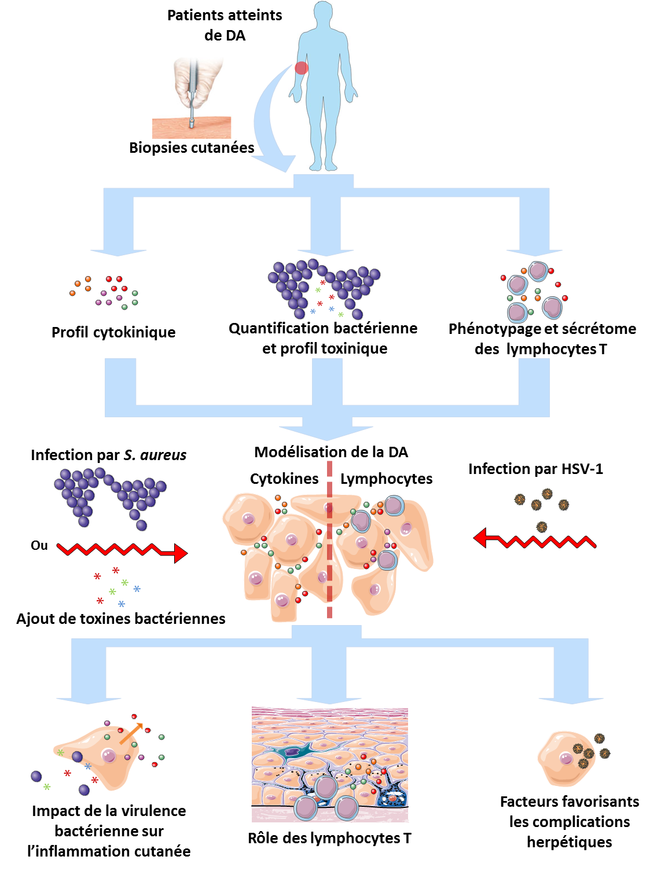





Atopic Dermatitis models
Atopic
Dermatitis
New AD models
Role of T cells secretome ?
Impact of S. aureus virulence ?
Factors favoring herpetic complications ?
Skin biopsy
Cytokinic profil
Bacteria and toxin
quantification
T cells secretome
S. aureus infection
AD models
Cytokines / T cells
HSV-1 infection
or
S. aureus toxin
Factors favoring
HSV complications
Damour et al, Clinical Reviews in Allergy & Immunology 2019
Damour et al, Virulence 2021
Role of S. aureus
Role of T cells

Slide 12
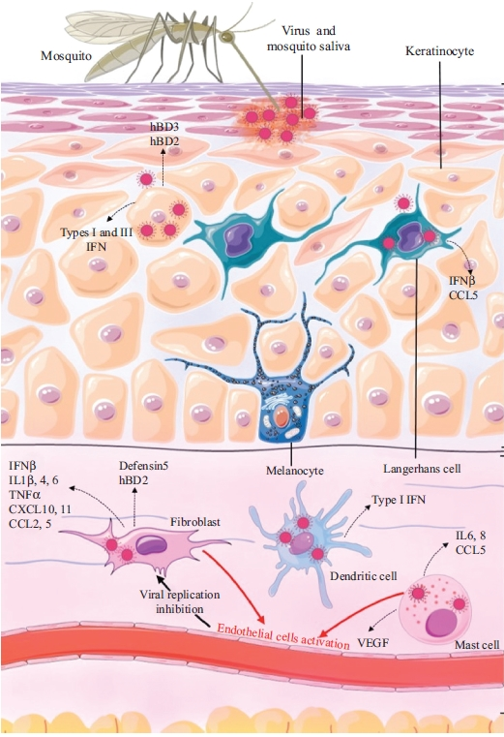
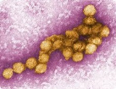
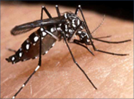
Cutaneous antiviral response to arbovirus infection
Inflammatory response induced during infection of human skin cells by West Nile and Usutu Virus
Innate immunity receptors involved and viral molecular patterns recognized
Role of antimicrobial peptides in the innate immune response against arboviruses
Study of another emerging virus : interactions between monkeypox virus and skin cells
Garcia et al, ECN 2017
Garcia et al, Frontiers in Cellular and Infection Microbiology 2018

