Slide 1
Polymer Self-Assembly & Life Sciences
A multidisciplinary group focusing on the interface
between polymer and life sciences

Slide 2
Polymer Self-Assembly & Life Sciences
A multidisciplinary group focusing on the interface
between polymer and life sciences
Main goals: design and synthesis of amphiphilic (block) copolymers
able to self-assemble in a controlled and predictable manner
into functional nano- or micron-sized particles
with specific morphologies (e.g., core-shell particles, worm-like micelles, polymersomes)
able to mimic or interact with living systems
for diverse applications (e.g., biomimicry, nanomedicine, tissue engineering)

Slide 3
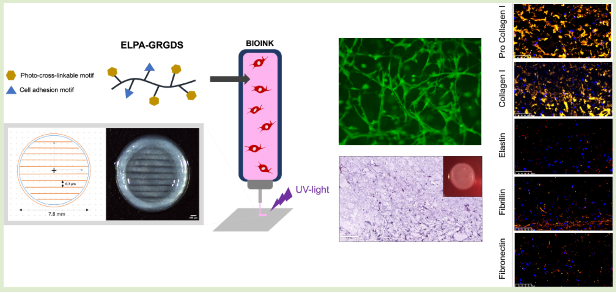
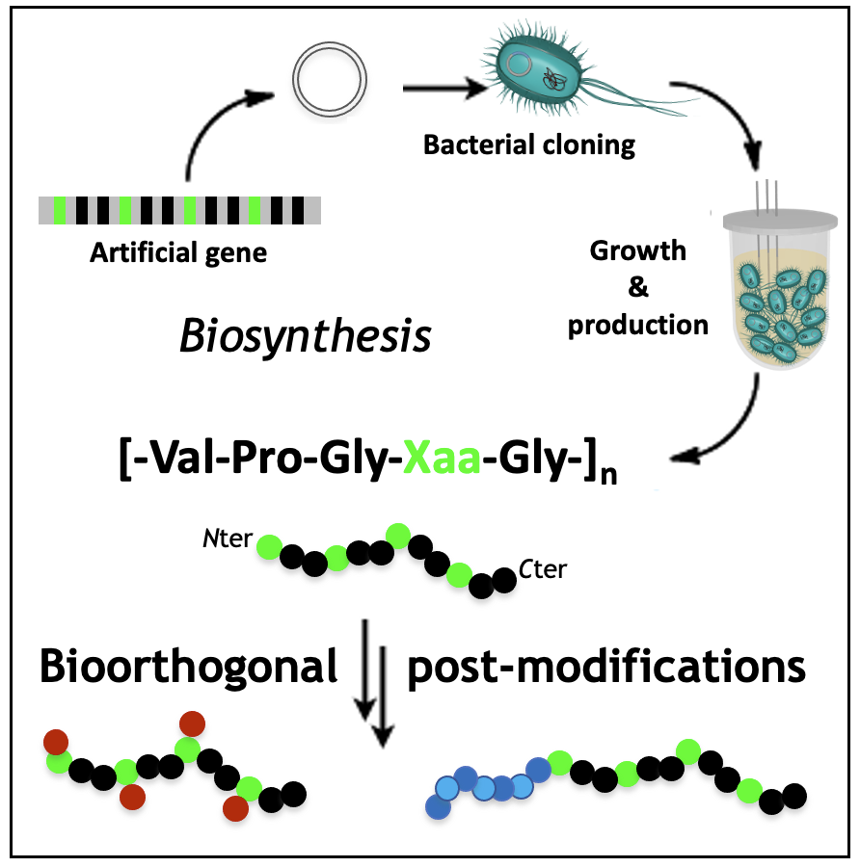
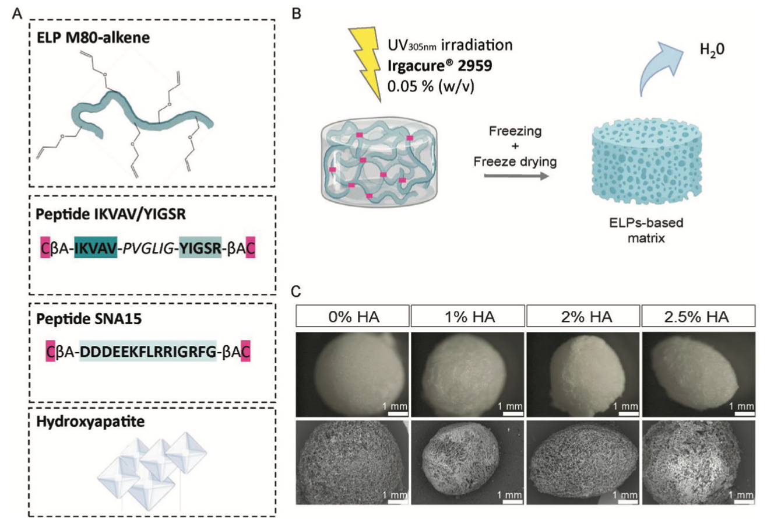
Projet transversal PEAU
Recombinant production of elastin-like polypeptides (ELPs)
and chemical / enzymatical post-modifications
Self-assembled gels for Bioprinting
and Tissue Engineering
M. Dai et al. Macromolecules 54, 327 (2021)
M. Dai et al. Biomacromolecules 22, 4956 (2021)
Mahmoudi et al. Advanced Healthcare Materials, 2303765 (2023)

Slide 4
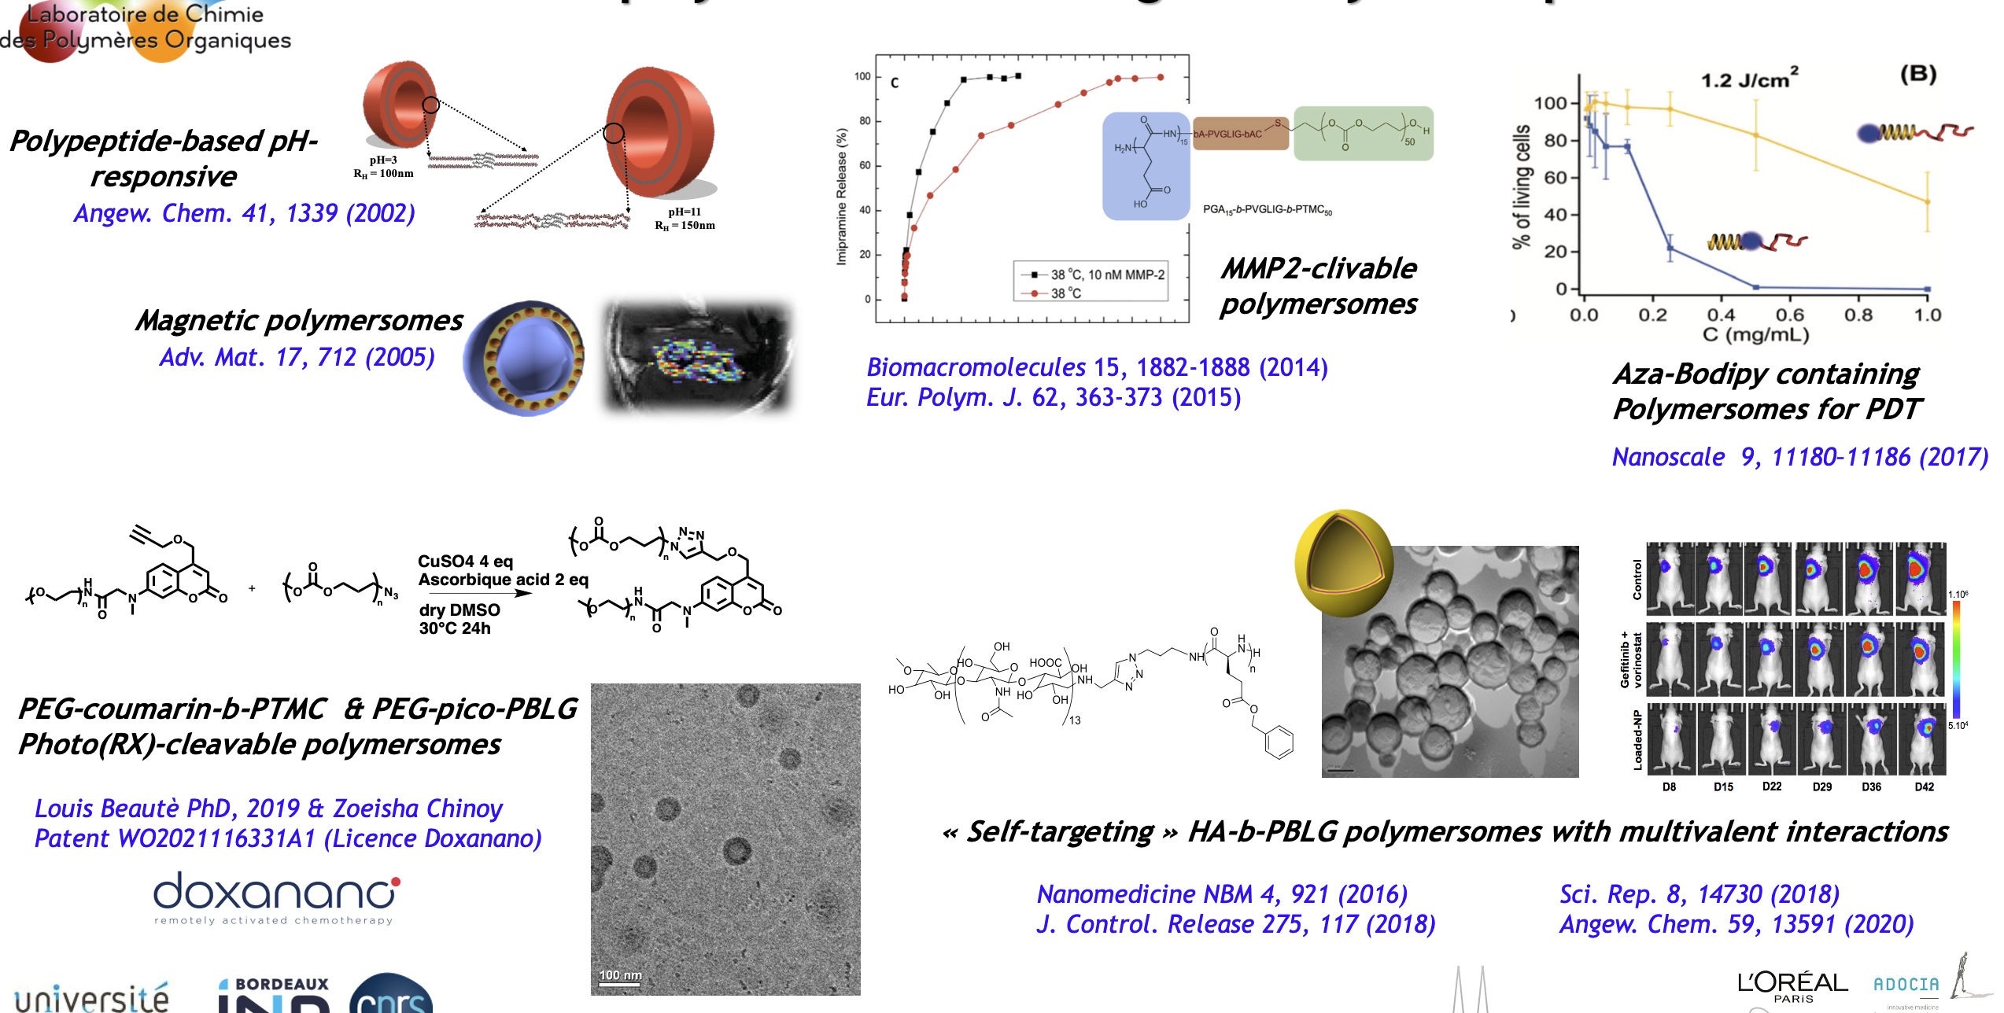
Projet INNOVATIONS THÉRAPEUTIQUES
Synthesis and self-assembly of biocompatible and biodegradable block copolymers
Loading of Active Pharmaceutical Ingredients
Stimuli-triggered release of the API

