Slide 1




Soumission d’un projet à
l’appel à projet European Innovation Council (EIC) pathfinder open 2025
UTILIZING REVERSIBLE REDOX-ACTIVE POLYMER COATINGS TO MITIGATE MICROBIALLY INFLUENCED
CORROSION (REPLY)
Coordination : Corinne Nardin, IPREM, UMR5254 CNRS – Université de Pau & des Pays de l’Adour
Présentation : Corinne Nardin, corinne.nardin@univ-pau.fr
Professor, School of Sciences
for the Energy and the Environment
Physical Chemistry
of surfaces & polymer Materials
Assemblée Générale, R³ HR²S, 26/05/2025, Bordeaux
Bordeaux, le 26 mai 2025
Notes:
Revêtement anti-bactérien de substituts osseux à base de céramiques phospho-calciques pour la prise en charge de lésions osseuses ouvertes infectées

Slide 2
New approaches to combat (bio)corrosion
Introduction
What is corrosion?
A redox process

Slide 3
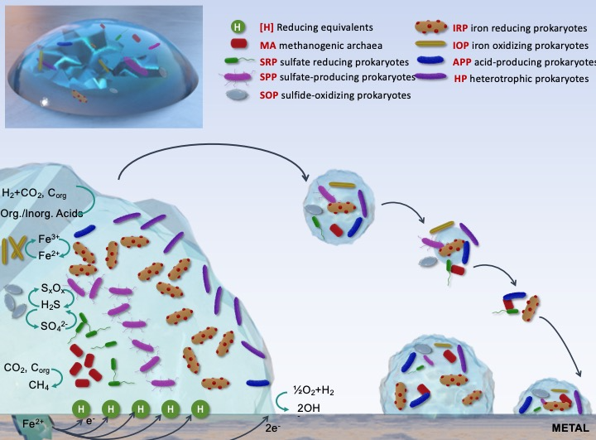
New approaches to combat (bio)corrosion
Introduction
What is bio corrosion?
A redox process

Slide 4
New approaches to combat (bio)corrosion
(Bio)Corrosion is of concern
For both technology providers & beneficiaries
Current approaches to combat (bio)corrosion:
Costly: 3-5% of GDP spent yearly in developed countries* (about 142 € billion for EU by 2040)
Face the Registration, Evaluation, Authorisation & Restriction of Chemicals regulation (REACH)
Toxic for the environment & harmful to human health
  Antibiotic resistant strain
  Nanoparticles
  Biocides
Affect several sectors
  Heath (implants)
  Energy storage and cooling systems
  Structural materials (aircrafts, ships, marine infrastructures)
The process depends on the material in its environment
Urgent Need for an antibiotic & other biocides- free solution
* S. Dua et al. Progress in Organic Coatings Volume 188, March 2024, 108231

Slide 5
New approaches to combat (bio)corrosion
Fundamentally new approach
Tackle the underlying mechanism of corrosion: redox process

Slide 6

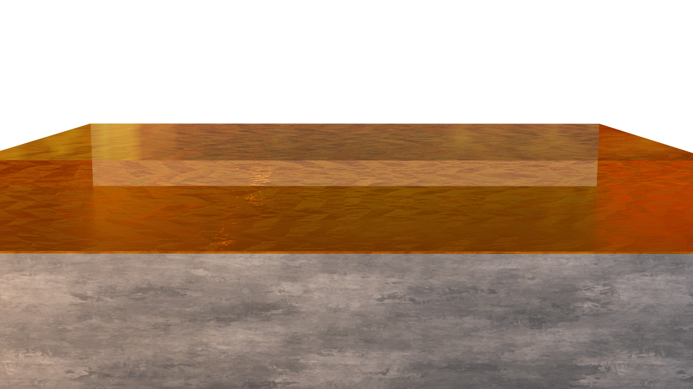
New approaches to combat (bio)corrosion
Fundamentally new approach
Tackle the underlying mechanism of corrosion: redox process
To be less depend on the material in its environment
With REACH compliant molecules
=> Safe for the environment and for human health
use of redox active polymer coatings
Hamper the redox process

Slide 7
New approaches to combat (bio)corrosion
Collaboration Vector
Tackle the underlying mechanism of corrosion: redox process

